Slide 1
Particle Model of matter

Slide 2
In this lesson we will review and expand on what we have learned about particles, as well as discuss what is meant by 'the particle model of matter'. After you have completed this lesson you should be able to:
Explain the Particle Model of Matter.
Discuss the benefits and limitations of using a model for the structure of matter.
Discuss the difference in particle behaviour as a result of matter being heated or cooled.
Evaluate how gas particles respond to changes in temperature.

Slide 3
What do we already know about particles?
All matter is made of particles that are constantly moving.
Different states of matter have different physical properties.
These properties depend on the bonds between the particles.
All this information is part of the particle model of matter. This model is used to explain the properties of solids, liquids and gases.

Slide 4
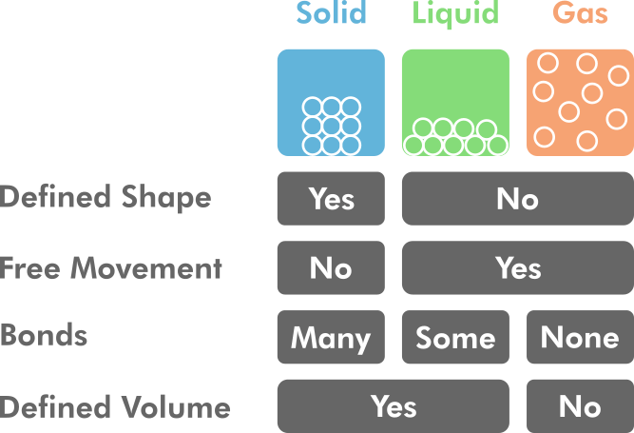

Slide 5
A scientific model is a simplified explanation of a concept that is difficult to observe directly.
We can observe solids, liquids and gases, and record how they behave, but we can’t observe the individual particles.
We can use the particle model to help us better understand why different states of matter have different physical properties. We can also use this model to predict how matter will behave under different conditions.

Slide 6


Scientists make lots of observations and use this information to create a model.
Although particles are too small to see, scientists can observe the behaviour of solids, liquids and gases, and create a model that fits these observations.
As technology improves, our ability to make more accurate observations also improves. As scientists make new discoveries or observations, the model may change to fit this new information.

Slide 7
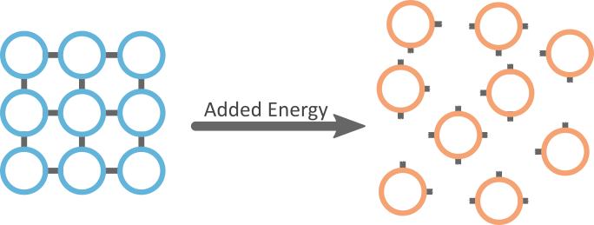
The number of bonds between particles is determined by the amount of energy the particles have.
When particles have more energy, they move faster and therefore more of the bonds between them will break. This means particles with more energy will have fewer bonds.
This is another important part of the particle model.

Slide 8
Particles move faster when their energy increases.
The particles in gases have the most energy and will move faster. The particles in solids have the least energy and will move slower.
The particles in a solid with more energy will vibrate faster than the particles in a solid with less energy.
Gas particles with more energy will move around a container faster than gas particles with less energy.

Slide 9
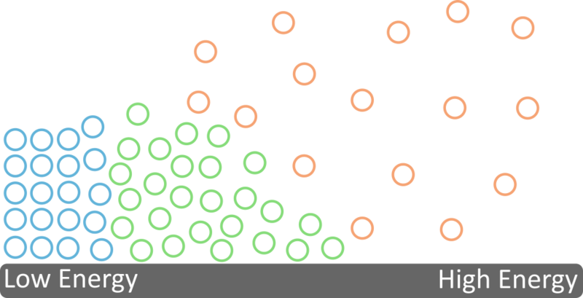
The particles in solids have low energy. This means the bonds between particles in solids won’t be easily broken and will stay close together.
The particles in liquids have enough energy to break some of the bonds between particles. This means liquids can move around but are still close together.
The particles in gases have enough energy to break all the bonds between particles. So gas particles can move around freely.

Slide 10

Energy can be added or removed from substances by changing the temperature of the substance.
Cooling the substance removes energy from the particles.
Heating the substance adds energy to the particles.

Slide 11
Particles that are heated will have more energy and therefore move faster and have fewer bonds.
Particles that are cooled will have less energy and therefore move slower and have more bonds.

Slide 12

Remember that gases do not have a fixed volume. One of the things that can change the volume of a gas is energy.
When a gas is cooled, the particles slow down and move closer together. This causes the volume of the gas to decrease because there is less space between the particles.

Slide 13

When a gas is heated, the particles speed up and spread out. This will increase the volume of the gas because there is more space between the particles.

